Slide 1
Raising the Bar: Striving to Improve Initial Therapy of PTCL
Ranjana Advani, MD
Stanford Cancer Institute
Stanford University School of Medicine
Stanford, California, United States

Slide 2

No Improvement in Outcome in A Decade of Patient Treatment 1992-2003
2-Year Relative Survival
80 –
75 –
70 –
65 –
60 –
55 –
50 –
45 –
40 –
35 –
30 –
DLBCL
x
x
x
x
2-Year Relative Survival Rate (%)
x
x
PTCL
92-93
94-95
96-97
98-99
00-01
02-03
Year of Diagnosis
PTCL, NOS
DLBCL
x
ALCL
Extranodal, nasal
AITL
Abouyabis AN, et al. Leuk Lymphoma. 2008;49(11):2099-2107.

Slide 3
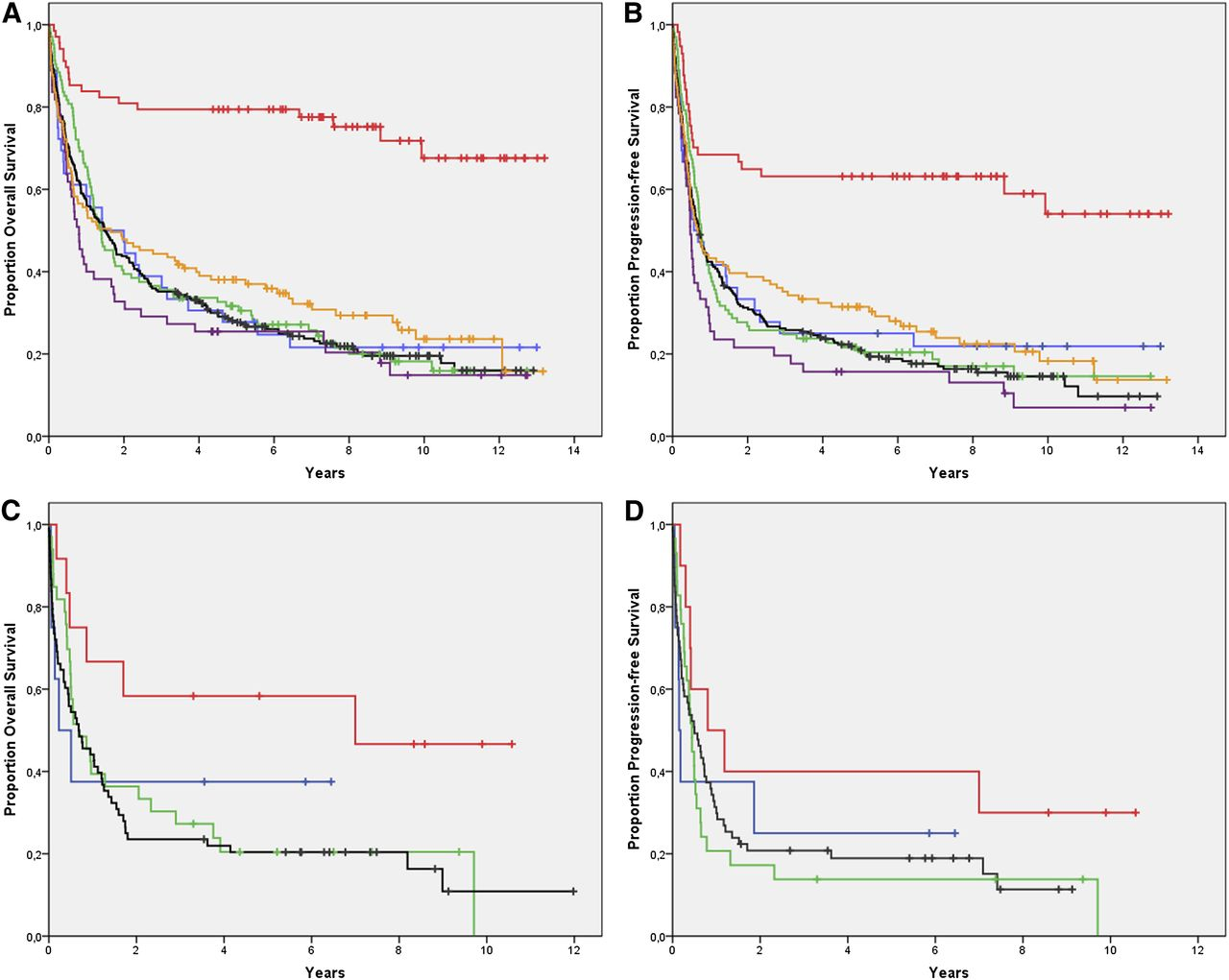
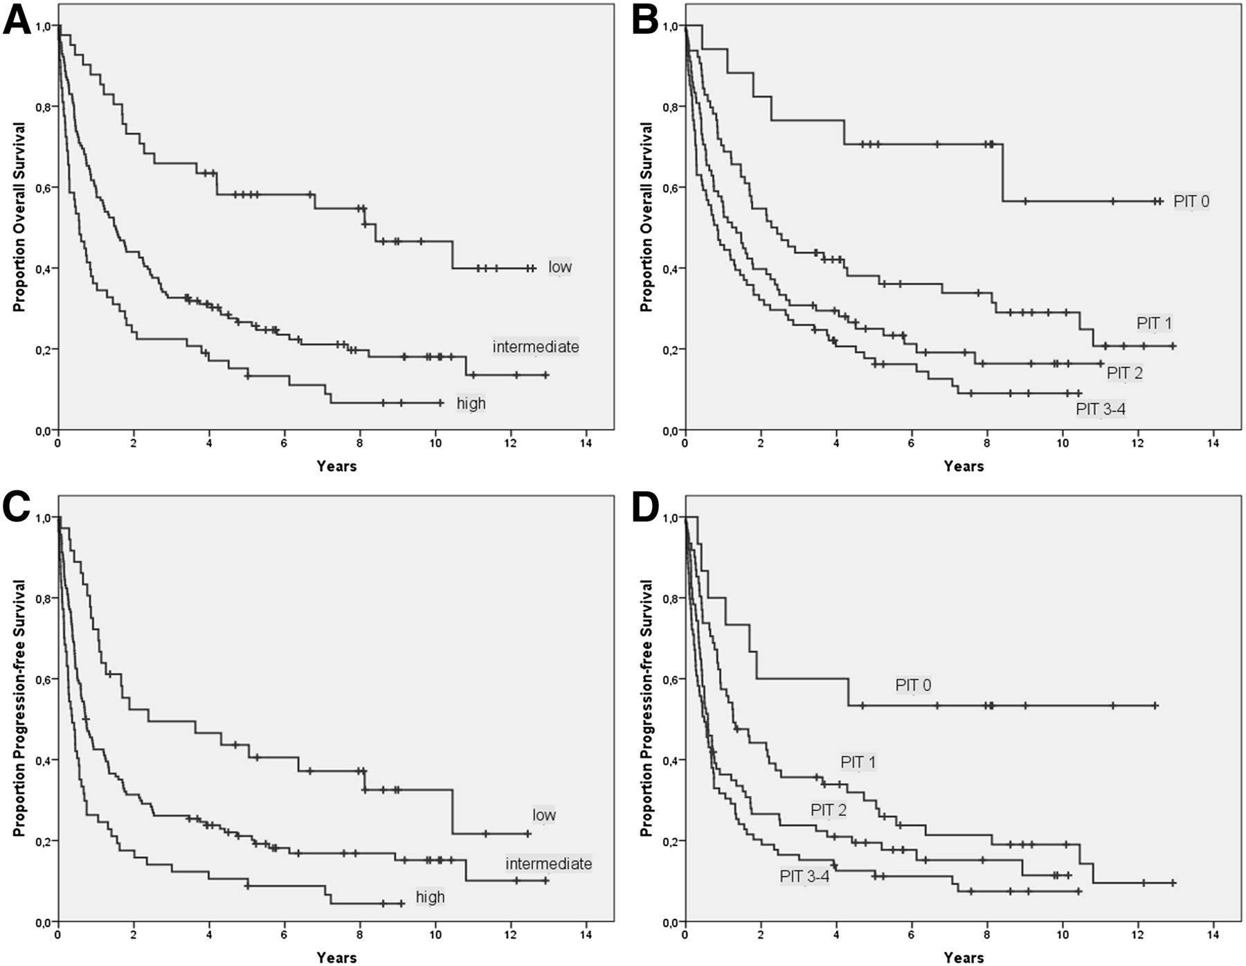
Outcomes of PTCL in Modern Era
Swedish Lymphoma Registry: Patients Treatment 2000-2009
Overall Survival (OS)
Progression-Free Survival (PFS)
OS
OS
International Prognostic Index (IPI)
Prognostic Index for PTCL-U (PIT)
Nodal Subtype
Nodal Subtype
ALK + ALCL
EN subtype
EN subtype
PFS-IPI
PFS-PIT
Ellin F, et al. Blood 2014;124(10):1570-1577.
Notes:
OS and PFS in 755 patients with PTCL. (A) OS among nodal subtypes: ALKpos ALCL (red line), ALKneg ALCL (orange line), ALKu ALCL (blue line), PTCL NOS (black line), AITL (green line), and TCL U (purple line). (B) PFS among nodal subtypes. (C) OS among extranodal subtypes: SPTCL (red line), HSTCL (blue line), NK/T, nt (green line), and EATL (black line). (D) PFS among extranodal subtypes.

Slide 4
PFS and OS of PTCL Compared to Matched Diffuse Large B-Cell Lymphoma (DLBCL) Patients in the Modern Era (US study)
Patient treatment 2000-2011
Achieving a complete response (CR) to front-line therapy significant on multivariate analyses
1.00 –
0.75 –
0.50 –
0.25 –
0.00 –
1.00 –
0.75 –
0.50 –
0.25 –
0.00 –
Log-rank P<.0001
DLBCL (0.5043)
PTCL (0.2340)
Log-rank P = .0014
DLBCL (0.6746)
PTCL (0.4435)
Survival Probability
Survival Probability
0 6 12 18 24 30 36 42 48 54 60
0 6 12 18 24 30 36 42 48 54 60
Progression-Free Survival Time, Months
Overall Survival Time, Months
Abramson JS, et al. Ann Oncol. 2014;25(11):2211-2217.

Slide 5
Reasons for Poor Outcomes
Diagnosis difficult
Needs expert pathology
Treated like B-cell NHL
CHOP or anthracycline-based therapy
Multidrug resistance (MDR)
Doxorubicin and vincristine are substrates
Outcome of patients who fail front-line therapy is poor
Not one disease
Molecular studies show distinct biological entities

Slide 6
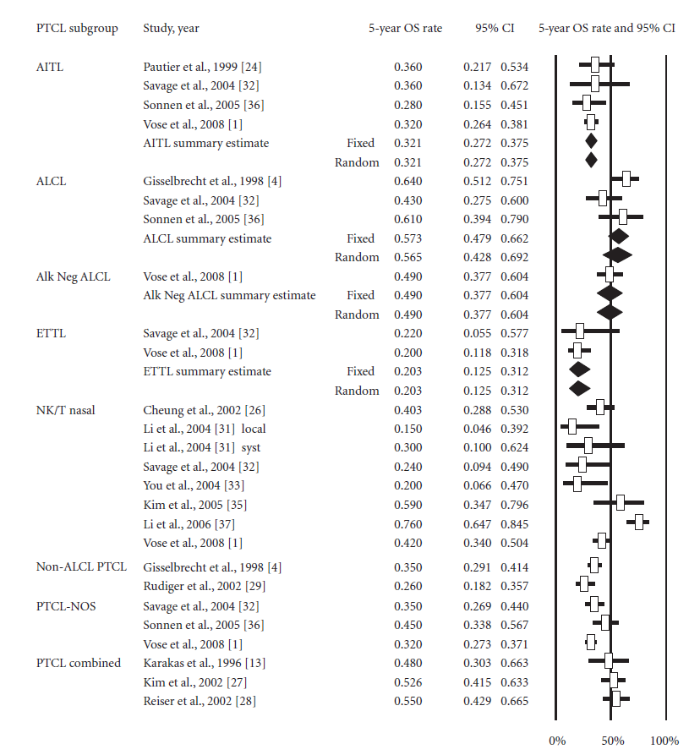
Front-Line Anthracycline-Based Therapy for
PTCL Meta-Analysis: OS In Older Series
ALCL excluded: Estimated 5-year OS ~ 37 % (95% CI 35%, 39%)
Abouyabis AN, et al. ISRN Hematol. 2011;2011:623924.
Notes:
Meta-analysis of complete response rate of patients undergoing anthracycline-based chemotherapy by PTCL subtype. Forest plot of the complete response rate along with summary estimates and its 95% CI in diamonds. Horizontal lines show the 95% CI for each trial. Only subtypes showing no evidence of heterogeneity were grouped. Within each subtypes, studies were ordered by year of reporting and alphabetical order. Squares on the plot are proportional to the weight of each study. Fixed effect and random effects models summary estimates are depicted in boldface

Slide 7
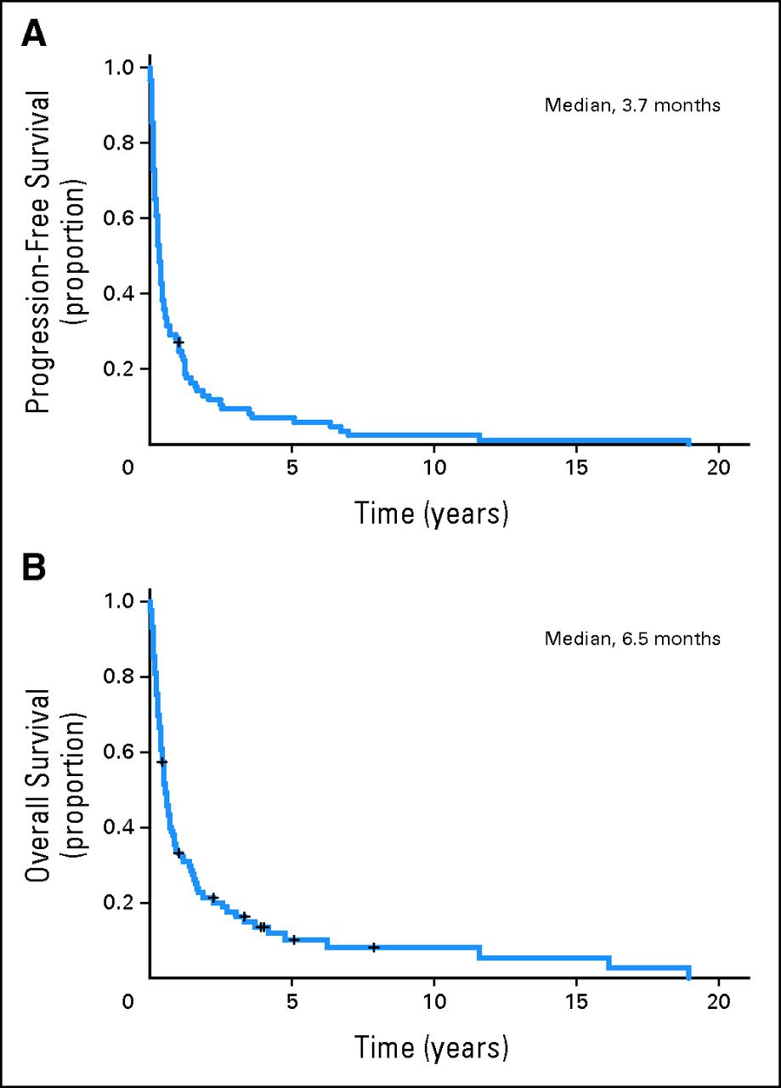
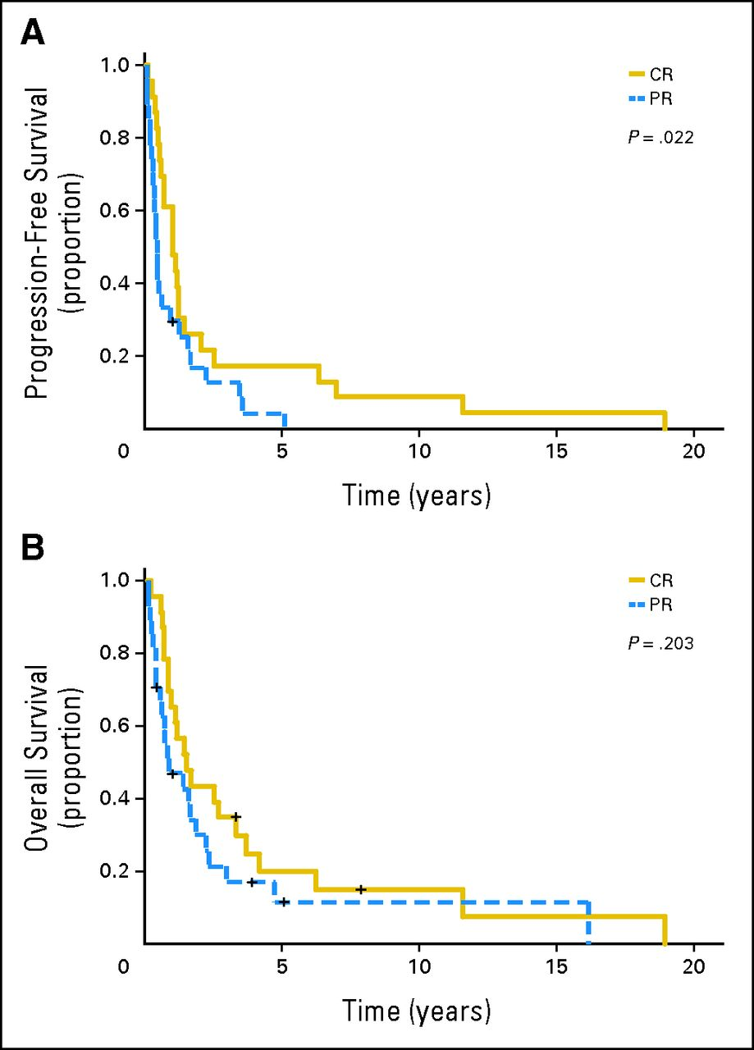
Poor Outcome (Second PFS and OS) After Relapse or Progression of PTCL
Mak V, et al. J Clin Oncol. 2013;31(16):1970-1976.
Notes:
(A) Second progression-free survival (median, 3.7 months) of patients treated with chemotherapy (n = 89) with relapsed or progressive peripheral T-cell lymphoma (PTCL) and (B) overall survival (median, 6.5 months) after first relapse or progression of PTCL.

Slide 8
Raising the Bar: Striving to Improve Initial Therapy of PTCL
Adding etoposide to anthracycline-based regimen
Adding rationally targeted drugs to CHOP
Consideration of transplant as consolidation
Alternative to CHOP (nonanthracycline-based regimen)
Adding novel agents to front-line setting

Slide 9
Raising the Bar: Striving to Improve Initial Therapy of PTCL
Adding etoposide to anthracycline-based regimen

Slide 10
Event-Free Survival (EFS) of Younger Patients With PTCL: GHGNHLSG
18-60 years of age, lactate dehydrogenase (LDH) ≤ upper normal value (UNV)
100
100
80
6 x CHOEP-14/21 (n = 42)
80
Etoposide (n = 103)
60
6 x CHOP-14/21 (n = 41)
60
EFS, %
EFS, %
Nonetoposide (n = 41)
40
40
20
P = .003
20
P = .004
0
0
0
20
40
60
80
100
0
20
40
60
80
100
100
Months
100
Months
80
Etoposide (n = 34)
80
Other major subtypes
ALCL, ALK+
Etoposide (n = 69)
60
60
EFS, %
Nonetoposide (n = 12)
EFS, %
40
40
Nonetoposide (n = 29)
20
P = .012
20
P = .057
0
0
0
20
40
60
80
100
0
20
40
60
80
100
Months
Months
Schmitz N, et al. Blood. 2010;116(18):3418-3425.

Slide 11
Phase II Study of Dose-Adjusted EPOCH in PTCL
Patient Treatment 1999-2009
Progression-Free Survival
Overall Survival
100 –
90 –
80 –
70 –
60 –
50 –
40 –
30 –
20 –
10 –
100 –
90 –
80 –
70 –
60 –
50 –
40 –
30 –
20 –
10 –
ALK +
ALK -
ALK -
85%
ALK +
ALK - versus +: P = .82
ALK - versus +: P = .95
Percent Survival
Percent Survival
Other subtypes
Other subtypes
50%
Median follow-up 10 years
Median follow-up 10 years
3 6 9 12 15 18
3 6 9 12 15 18
Years on Study
Years on Study
Dunleavey K, et al. Blood. 2011;118: Abstract 1618.

Slide 12
Raising the Bar: Striving to Improve Initial Therapy of PTCL
Adding rationally targeted drugs to CHOP or anthracycline-based therapy

Slide 13
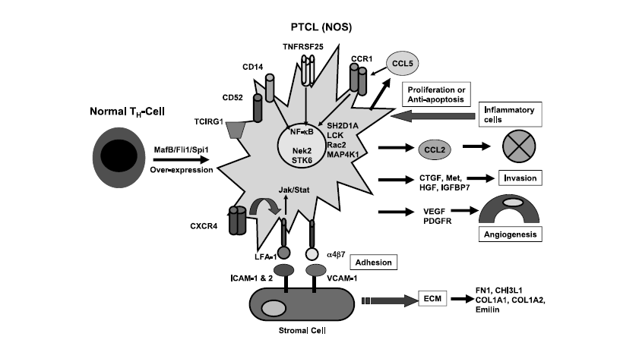
Genes Overexpressed in PTCL
Vascular biology
Protein ubiquination
MDR related
Regulation of transcription
Chemo taxis
Immune response
Mahadevan D, et al. Mol Cancer Ther. 2005;4(12):1867-1879.
Notes:
A predictive model delineating the tumor profile signature of PTCL-NOS. Activation of oncogenic transcription factors (MAFB, FLI1, and SPI1)
promotes overexpression of chemokines (CCL2 and CCL5) and chemokine receptors (CCR1 and CXCR4). These acting in an autocrine and paracrine
manner recruit stromal fibroblasts, inflammatory immune cells, and endothelial cells to form a complex network of tumor tissue. The overexpression of
integrins (LFA1 and VLA4) on the tumor cells and their binding partners on stromal cells (ICAM1, ICAM2, and VCAM1) promotes tumor-stroma cross-talk
that activates proliferative signaling pathways (JAK/STAT), ECM formation (FN1, COL1A1, COL1A2, CHI3L1, and emilin), and stromal-derived cytokines/
growth factors (CTGF and CYR61). Several tumor-derived angiogenesis promoters (VEGF, PDGF-CC, FGF7, PDGFR, and CSF1R) are overexpressed, which
helps maintain a complex angiogenic process. The recruitment of inflammatory immune cells that enhance tumor growth and the production of invasive
factors (HGF, MET, CTGF, and IGFBP7) bode for an aggressive T-cell lymphoma. Moreover, the overexpression of NF-nB-driven proliferative factors
(TCIRG1, CD14, CD52, TNFRSF25, and CCR1) inhibits many forms of apoptosis and contributes to chemoresistance. The overexpression of NEK2 and
STK6 contributes to cell cycle dysregulation and resultant aneuploidy. Several markers of proliferation are also overexpressed (SH2D1A, LCK, Rac2, and
MAP4K1), which contributes to the overall survival and antiapoptotic pathways.

Slide 14
Phase II Study of Bevacizumab and CHOP (A-CHOP) for PTCL ECOG 2404
A-CHOP
Cycles 1-3
Continuing Bevacizumab
ASSESS
A-CHOP
Cycles 4-6
RESPONSE
Patients with CR, functional CR or Cru after cycles 3 and 6 of A-CHOP
AND
Responding patients completing all 8 cycles of A-CHOP
Will start on continuing bevacizumab therapy:
Bevacizumab 15 mg/kg over 30 minutes on day 1 of each cycle x8 cycles
A-CHOP x 3 cycles
Day 1
Bevacizumab followed by CHOP
Cyclophosphamide 750 mg/m²
Doxorubicin 50 mg/m²
Vincristine 1.4 mg/m²
Predisone 100 mg daily (days 1-5)
ASSESS
RESPONSE
R
E
G
I
S
T
E
R
CR⁴
A-CHOP
X 3 cycles
CR⁴
ASSESS
RESPONSE
CR⁴ or PR
Continuing A-CHOP
Cycles 7-8
ASSESS
SD or PR
RESPONSE
A-CHOP
X 3 cycles
CR⁴, SD, or PR
A-CHOP
X 2 cycles
PD
PD
SD or PD
Accrual Goal = 43
End Protocol Treatment

Slide 15
Phase II Study of Bevacizumab and CHOP (A-CHOP) ECOG 2404
Progression-Free Survival
Overall Survival
1.0 -
0.8 -
0.6 -
0.4 -
0.2 -
0.0 -
1.0 -
0.8 -
0.6 -
0.4 -
0.2 -
0.0 -
ORR 90% BUT not durable
1-year PFS 44%
EF monitored after A-CHOP before bevacizumab
22 pts rec’d at least 4 cycles of A-CHOP
Cardiac toxicity in 5/22 pts (22%)
Gr 3-4 CHF in 4 pts (18%)
PFS Probability
OS Probability
0 1 2 3 4 5
0 1 2 3 4 5
Years
Years
Progression-Free Survival Based on Histology
Overall Survival Based on Histology
1.0 -
0.8 -
0.6 -
0.4 -
0.2 -
0.0 -
1.0 -
0.8 -
0.6 -
0.4 -
0.2 -
0.0 -
AITL
ALK-neg ALCL
PTCL-NOS
AITL
ALK-neg ALCL
PTCL-NOS
PFS Probability
OS Probability
Log-rank 2-sided P = .02
Log-rank 2-sided P = .05
0 1 2 3 4 5
0 1 2 3 4 5
Years
Years
Advani AS, et al. Br J Haematol. 2011;153(4):504-507; Ganjoo K, et al Leuk Lymphoma. 2014;55(4):768-772.

Slide 16
GELA-LNH05-1T Delmer et al ASCO 2009 # 8554
CR 49% (similar to results with ACVBP alone), more toxicity
Delmer A, et al. J Clin Oncol. 2009;27(15s): Abstract 8554.

Slide 17
Bortezomib+CHOP as First-Line for Stage 3-4 PTCL
ORR 76%, CR 65%, 3-year PFS 37%, OS 47%
CR (n = 30)
PR (n = 5)
UK (n = 2)
PD (n = 9)
14
4
1.0 –
0.8 –
0.6 –
0.4 –
0.2 –
0.0 –
1.0 –
0.8 –
0.6 –
0.4 –
0.2 –
0.0 –
Relapse (n = 18)
CTCL
16
5
13
1
2
8
1
Death (n = 24)
CTCL
ALCL
Overall Survival
Alive with CR (n = 22)
Progression –Free Survival
AITL
1.0 –
0.8 –
0.6 –
0.4 –
0.2 –
0.0 –
ALCL
AITL
PTCL-NOS
PTCL-NOS
ENKTL
ENKTL
Survival
OS
0 10 20 30 40 50 60
0 10 20 30 40 50 60
Months
Months
PFS
0 10 20 30 40 50 60
Months
Kim SJ, et al. Eur J Cancer. 2012;48(17):3223-3231.

Slide 18
Raising the Bar: Striving to Improve Initial Therapy of PTCL
Consideration of transplant as consolidation

Slide 19
What Are the Data Supporting ASCT for PTCL?
No randomized clinical trial comparing chemotherapy vs ASCT
Retrospective data from prospective randomized trials for aggressive lymphomas
GELA pooled analysis with matched controls no advantage to ASCT¹
Prospective data
Variable front-line chemotherapy
Variable preparative regimen for ASCT
Variable inclusion criteria
1. Mounier N, et al. Ann Oncol. 2004;15(12):1790-1797.

Slide 20
ASCT in PTCL: Upfront Treatment Prospective PTCL Restricted Trials
Citation | Patients , n | Age, y | Regimen | Tx rate | CR/PR, % | OS, % | FU
Corradini Leukemia 2006 | 62 Incl ALK + ALCL | 43 | 1. APO → DHAP → HD Mito./Mel 2. MACOP-B → HD AraC/Mito → BEAM | 74 | 72 | 34 Alk- ALCL 21 | 12 y
Rodriguez Eur J Hematol 2007 | 26 | 44 | MegaCHOP/IFE → BEAM | 73 | 81 | 73 | 3 y
D’Amore JCO 2012 | 160 | 55 | CHOEP-14 → BEAM/BEAC | 70 | 82 | 50 | 5 y
Mercadal Ann Onc 2008 | 41 | 47 | HighCHOP/ ESHAP altern. → BEAM/BEAC | 41 | 59 | 39 | 4 y
Reimer JCO 2009 | 83 | 47 | CHOP → DexaBEAM/ESHAP → HD Cy + TBI | 66 | 71 | 48 | 3y
Ahn ASH 2011 | 46 | 45 | CHOP → → Cy + VP16 +Etop | 67 | 67 | 48 | 3y
~ 25%-60% do not get to ASCT, OS ~ 50%
Adapted from Reimer P, et al. Adv Hematol. 2010;2010:320624.

Slide 21
ASCT in PTCL Summary of Prospective Trials
~25%-60% do not get to ASCT due to disease progression during primary therapy
~20% relapse within the first year after ASCT
Additional ~10% relapse by 2 years post ASCT
Does ASCT as consolidation improve results or just select for healthier people with chemosensitive disease?
Factors (high-risk disease) predict for poor outcome after chemotherapy and ASCT

Slide 22
Alemtuzumab (A) + Chemotherapy First-Line Treatment of PTCL
Citation | n | PTCL | A dose, mg | Chemo | ORR/CR | % PFS/EFS | % Toxicity
Gallamani Blood 2007 | 24 | 14 | 30 | CHOP-28 | 75/71 (50% PTCL) | 48 (2 yr) | 17% G4 infection
Kim Cancer Chemother Pharmacol 2007 | 20 |  | 30 | CHOP | 80/65 | 43 (1 yr) | 10% death infection
Kluin-Nelemans Annals of Oncol 2011 | 20 | 10 | 30x3 | CHOP-14 | 90/60 | 27 (2 yr) | 15% EBV=LPD20% TRM

Slide 23
Phase II Study of Intensified Chemoimmunotherapy With or Without SCT in Newly Diagnosed Patients With PTCL
Clin A study
Clin B study
Enrolled (n = 64)
Enrolled (n = 28)
<60 y
Med 48 y
>60 y - 75 y
Med 68 y
Analyzed (n = 61)
Analyzed (n = 25)
CHOP-AL x2
CHOP-AL
PD (n = 5)
CHOP-AL
First HyperCHidam (n = 56)
PD (n = 6)
CHOP-AL
PD (n = 4)
toxic deaths (n = 3)
CHOP-AL
Second HyperCHidam (n = 44)
No 2nd HyperCHidam (n = 3)*
PD (n = 1)
PD (n = 7)
CHOP-AL
toxic deaths (n = 2)
PD (n = 1)
Transplantation Phase (n = 38)
toxic deaths (n = 1)
CHOP-AL
PD (n = 4)
allo SCT (n = 23)
auto SCT (n = 14)
no transplant (n = 1)**
toxic deaths (n = 2)
Clinical Response (n = 12)
Alemtuzumab 30 mg
Alemtuzumab 10 mg
*these 3 patients underwent transplantation after 1 cycle HyperCHidam; **physician decision
Corradini P, et al. Leukemia. 2014;28(9):1885-1891.

Slide 24
Results Arm A: Estimated 4-Year Outcomes Median Follow-Up 40 Months, 62% Received SCT
1.0 –
8.9 –
0.6 –
0.4 –
0.2 –
0.0 –
1.0 –
8.9 –
0.6 –
0.4 –
0.2 –
0.0 –
DFS (CR6m)
DFS
CR for at least 6 mo
Probability
Probability
65%
78%
No diff auto vs allo
4-y OS 92% vs 69%
P = 0.8
4-y PFS 70% vs 69%
P = 0.9
CMV 14%
0 6 12 18 24 30 36 42 48
0 6 12 18 24 30 36 42 48
Time, Months
Time, Months
1.0 –
8.9 –
0.6 –
0.4 –
0.2 –
0.0 –
1.0 –
8.9 –
0.6 –
0.4 –
0.2 –
0.0 –
PFS
OS
Probability
Probability
44%
49%
0 6 12 18 24 30 36 42 48
0 6 12 18 24 30 36 42 48
Time, Months
Time, Months
Corradini P, et al. Leukemia. 2014;28(9):1885-1891.

Slide 25
Results Arm B: Estimated 4-Year Outcomes Median Follow-Up 48 Months Stopped Early Due to Poor OS
1.0 –
8.9 –
0.6 –
0.4 –
0.2 –
0.0 –
1.0 –
8.9 –
0.6 –
0.4 –
0.2 –
0.0 –
44%
DFS (CR6m)
DFS
Conclusions:
Alemtuzumab cannot be safely used with SCT
Allo transplant not recommended outside trial
Alemtuzumab low dose also toxic
Probability
Probability
51.3%
CR for at least 6 mo
0 6 12 18 24 30 36 42 48
0 6 12 18 24 30 36 42 48
Time, Months
Time, Months
1.0 –
8.9 –
0.6 –
0.4 –
0.2 –
0.0 –
1.0 –
8.9 –
0.6 –
0.4 –
0.2 –
0.0 –
31%
26%
Probability
Probability
OS
PFS
0 6 12 18 24 30 36 42 48
0 6 12 18 24 30 36 42 48
Time, Months
Time, Months
Corradini P, et al. Leukemia. 2014;28(9):1885-1891.

Slide 26
Ongoing Phase III Trials
German Group
Auto
SCT
Auto
SCT
DHAP
BEAM
CHOEP 14
CHOEP 14
CHOEP 14
CHOEP 14
CHOEP 14
CHOEP 14
R
FBC
Allo
SCT
Allo
SCT
CHOEP 14
DHAP
CHOEP 14
CHOEP 14
CHOEP 14
CHOEP 14
CHOEP 14
No trial addressing chemo versus transplant
A = Alemtuzumab 30 mg
Nordic/ACT 1 Trial
Auto
SCT
BEAM
CHOP 14
CHOP 14
CHOP 14
CHOP 14
CHOP 14
CHOP 14
R
BEAM
Auto
SCT
A-CHOP 14
A-CHOP 14
A-CHOP 14
A-CHOP 14
-CHOP 14
-CHOP 14

Slide 27
Raising the Bar: Striving to Improve Initial Therapy of PTCL
Alternative to CHOP (nonanthracycline based regimen)

Slide 28
S0350 Regimen (PEGS): Phase II Trial in PTCL Cisplatinum, Etoposide, Gemcitabine Plus Solumedrol
Rationale: Use non MDR substrates due to high P glycoprotein expression in PTCL
(non adriamycin- or vincristine-based regimen)
PEGS schema: administered q 21 days
Cisplatinum: 25 mg/m² IV d1-4
Etoposide: 40 mg/m² IV d1-4
Gemcitabine: 1000 mg/m² IV d1
Solumedrol: 250 mg IV d1-4
Objectives: ORR, 2-y PFS, OS, tolerability
Molecular studies (GEP), P glycoprotein assessment
Accrual 6/55 over 2 years
Amended to include relapsed disease

Slide 29
Response
ORR [CR + PR] = 39% [13/33] , average Rx 5.5 cycles
2-year OS = 32% (95% CI: 8%-56%)
Median OS = 17 mo (95% CI: 15 mo to 20 mo)
Response | N (%) | Histologic Subtype
CR | 6 CONFIRMED (18%) 2 UNCONFIRMED (6%) | PTCL (NOS) = 4 ALCL (ALK-) = 2 PTCL (NOS) = 2
 | TOTAL = 8 (24%)
PR | 5 (15%) | PTCL (NOS) = 3 ALCL (ALK-) = 1 AITL = 1
STABLE | 4 (12%)
Overall Survival
100%
2-Year
At Risk
Deaths
Estimate
80%
S0350
33
17
32%
60%
40%
20%
0%
0
1
2
3
4
Years from Registration
Mahadevan D, et al. Presented at the 2010 International Conference on Malignant Lymphoma.

Slide 30
Raising the Bar: Striving to Improve Initial Therapy of PTCL
Adding novel agents to front-line setting

Slide 31
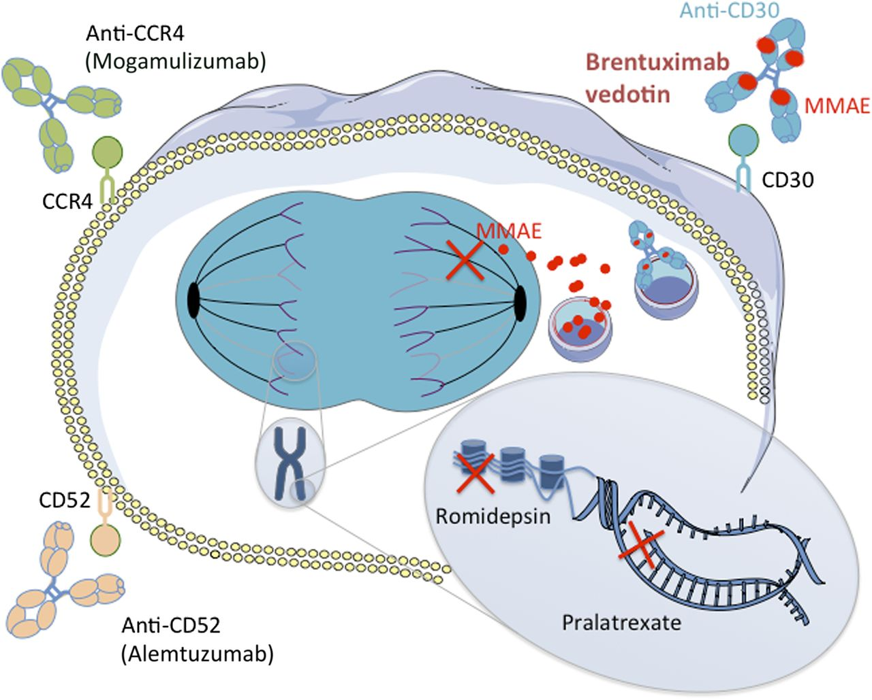
Mechanisms of Action of New Drugs in PTCL
Belinostat
Adapted from Bachy E, et al. Blood. 2014;123(20):3059-3060.
Notes:
Mechanisms of action of new drugs in PTCL. Two naked antibodies targeting the CD52 and CCR4 molecules (alemtuzumab and mogamulizumab, respectively) have shown interesting potency in PTCL by mediating antibody-dependent cell-mediated and complement-dependent cytotoxicity. Romidepsin is an HDAC, which is able, among other mechanisms, to restore expression of proapoptotic genes. Pralatrexate is a dihydrofolate reductase inhibitor that impedes DNA synthesis. BV is an ADC combining an anti-CD30 monoclonal antibody attached by a protease-cleavable linker to a cytotoxic agent, the MMAE. MMAE is released upon internalization by CD30-expressing cells and disrupts microtubule polymerization. HDAC, histone deacetylase inhibitor.

Slide 32
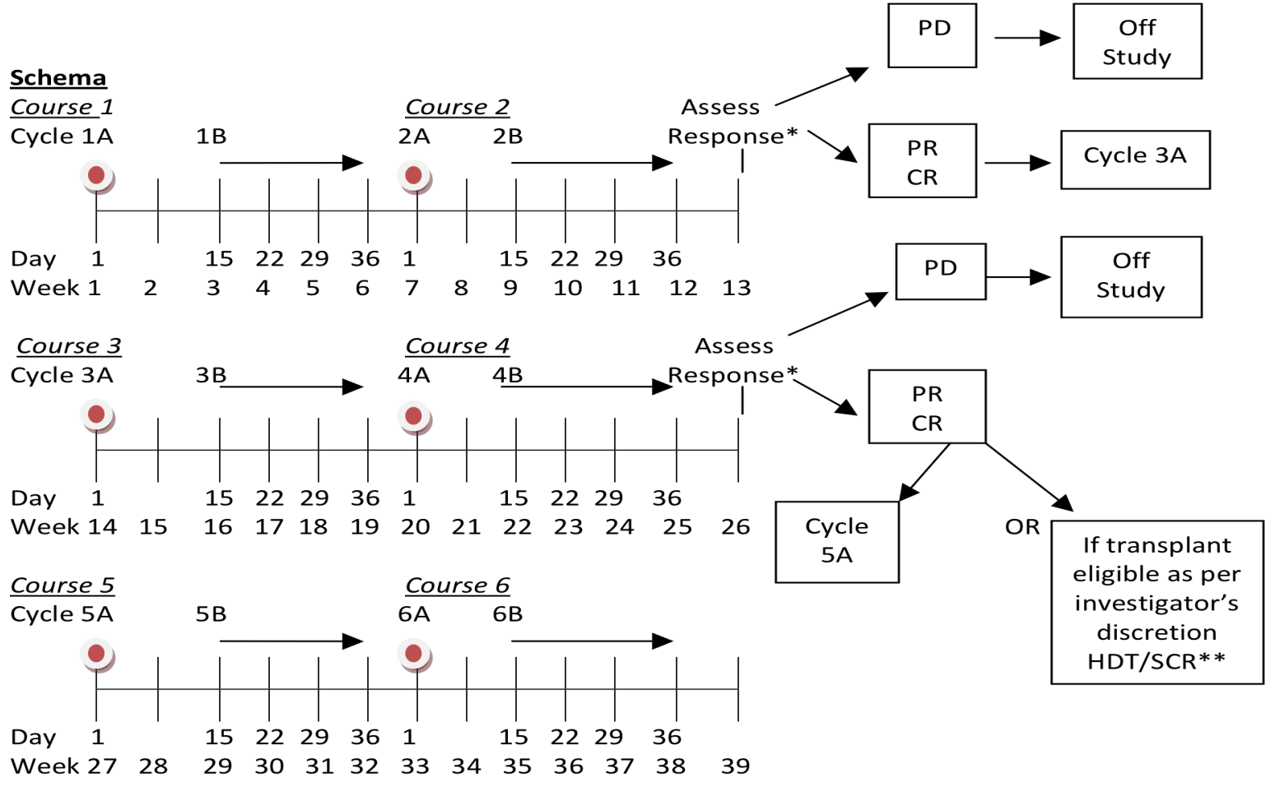
CEOP-P As Front-Line Therapy for Patients With Stage II- IV Peripheral T-Cell NHL
Cycle A
Cyclophosphamide 750 mg/m² d1 IV
Etoposide 100 mg/m² d1-3# IV
Vincristine 1.4 mg/m² (capped at 2 mg) d1 IV
Prednisone 100 mg PO d1-5
*Pegfilgrastim 6 mg d4 wk 1 of each course SQ
#Etoposide can be given PO on d2 and d3 at double dose of 100 mg/m² BID
Cycle B
Pralatrexate 30 mg/m² d1 IV q wk x3
*Filgrastim (G-SCF) 300 mcg d30 of each course SQ (optional, per institutional standards)
SCHEMA NOTE: Patients achieving SD after 4 courses (1, 2, 3, 4) will receive 2 additional courses (5, 6) and then be reevaluated for response post course 6. *Pegfilgrastim/filgrastim are suggested/optional per MD choice.
**HDT/SCR, high-dose therapy/stem-cell rescue (see section 5.7)

Slide 33
CEOP-P: Results
CR rate (50%) at end of therapy suggests the regimen useful per study design
Primary statistical aim of improving CR from 40%-60% not met
Estimated 1- and-2 year PFS are 50% and 34% respectively.
-Age <60 y, a low IPI score, achieving a CR, and consolidation with ASCT were statistically significant for better PFS
Estimated 1- and 2-year OS is 64%
Defining optimal front-line therapy in PTCL continues to be a challenge and an unmet need
1.0 –
0.8 –
0.6 –
0.4 –
0.2 –
0.0 –
PFS
0 6 12 18 24
Advani RH, et al. Blood. 2013;122: Abstract.

Slide 34
Brentuximab Vedotin Administered Concurrently or Sequentially With Multiagent Chemotherapy As Front-Line Treatment of ALCL and Other CD30-Positive Mature T-Cell and NK-Cell Lymphomas
Med age 56, 69% stage 3-4, 73% ALCL
Pretreatment (Up to 28 days)
Study Treatment (21-day cycle)
End of Treatment (~30 days after last dose of study drug)
Sequential Treatment
Brentuximab vedotin (2 cycles)
Screening
Baseline/ enrollment
CHOP (6 cycles)
Brentuximab vedotin (8 cycles)
End of treatment visit
Combination Treatment
DLT evaluation (6 patients – 1 cycle)
Screening
Baseline/ enrollment
BV + CHP (6 cycles)
Brentuximab vedotin (10 cycles)
End of treatment visit
Cycle 1 2 3 4 5 6 7 8 9 10 11 12 13 14 15 16
Fanale MA, et al. J Clin Oncol. 2014;32(28):3137-3143.
Notes:
Study schema showing screening, study treatment, and end of treatment for the sequential and combination treatment approaches. Sequential treatment included brentuximab vedotin (BV; two cycles) followed by cyclophosphamide, doxorubicin, vincristine, prednisone (CHOP; six cycles). The combination-treatment approach involved treatment with BV plus CHOP without vincristine (CHP; six cycles) and included a cohort to evaluate any dose-limiting toxicities (DLT; and the maximum-tolerated dose) during cycle 1. Responding patients were eligible to receive subsequent single-agent brentuximab vedotin for eight cycles (sequential treatment) or 10 cycles (combination treatment). During the follow-up period, after receiving the last dose of the study drug, patients were assessed for survival and disease status every 3 months until death or study closure.

Slide 35
Response After Sequential or Combination Treatment
 |  |  | Combination
 | Sequential ALCL n = 13 |  | ALCL n = 19 |  | Non-ALCL n = 7 |  | Total n = 26
Response | No. | % | No. | % | No. | % | No. | %
Objective response | 11 | 85 | 19 | 100 | 7 | 100 | 26 | 100
Complete remission | 8 | 62 | 16 | 84 | 7 | 100 | 23 | 88
Partial remission | 3 | 23 | 3 | 16 | 0 |  | 3 | 12
Stable disease | 0 |  | 0 |  | 0 |  | 0
Progressive disease | 2 | 15 | 0 |  | 0 |  | 0
Response assessment per investigator at cycle 8 (sequential treatment), cycle 6 (combination treatment), or at last available response assessment for patients who discontinued treatment before these timepoints.
Fanale MA, et al. J Clin Oncol. 2014;32(28):3137-3143.
Notes:
Cheson BD, Pfistner B, Juweid ME, et al:
Revised response criteria for malignant lymphoma.
J Clin Oncol 25:579-586, 2007

Slide 36
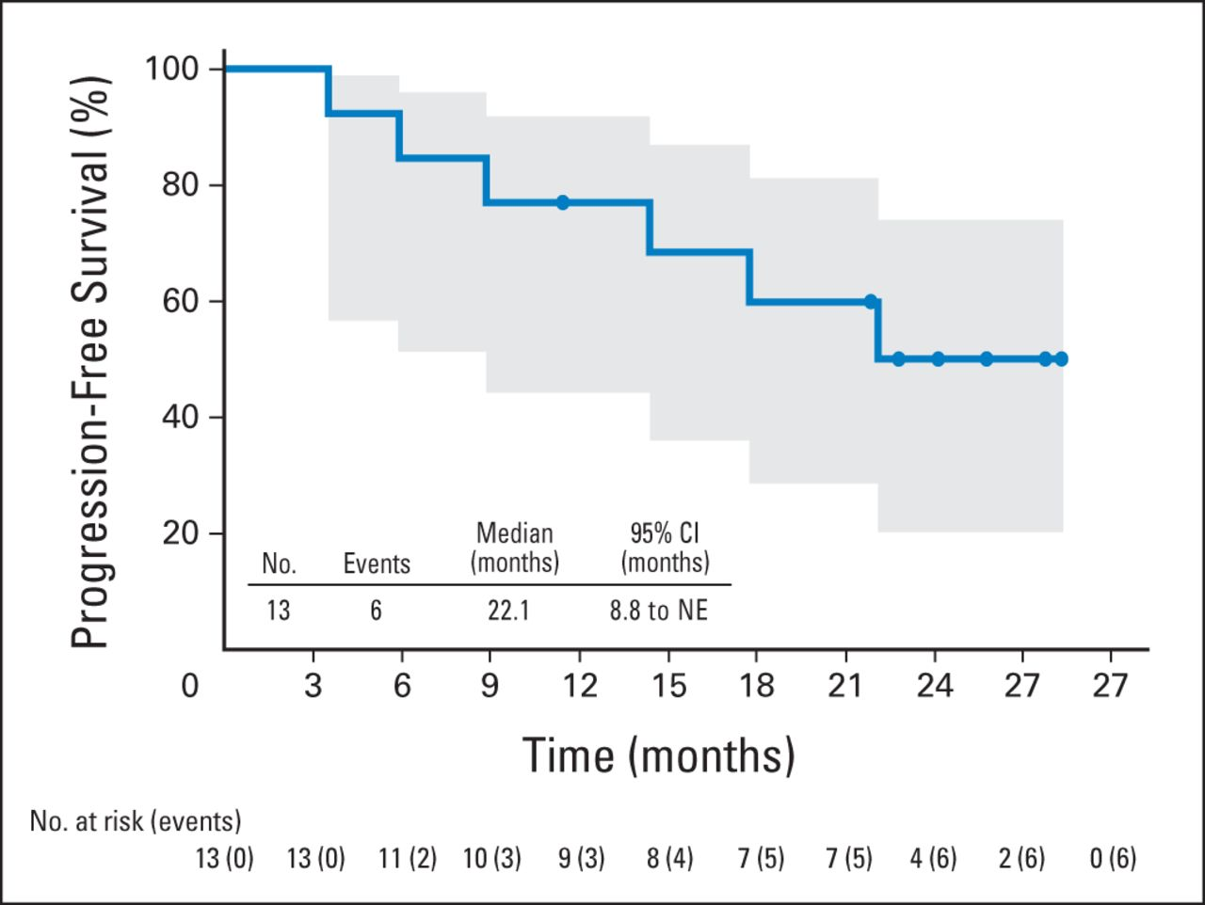
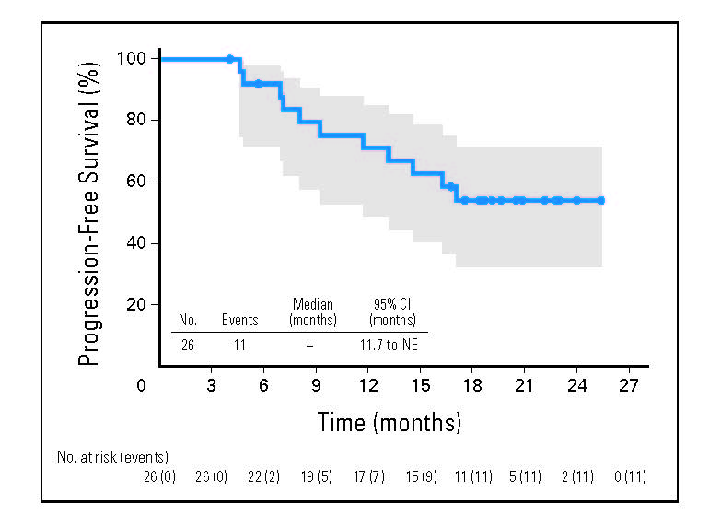
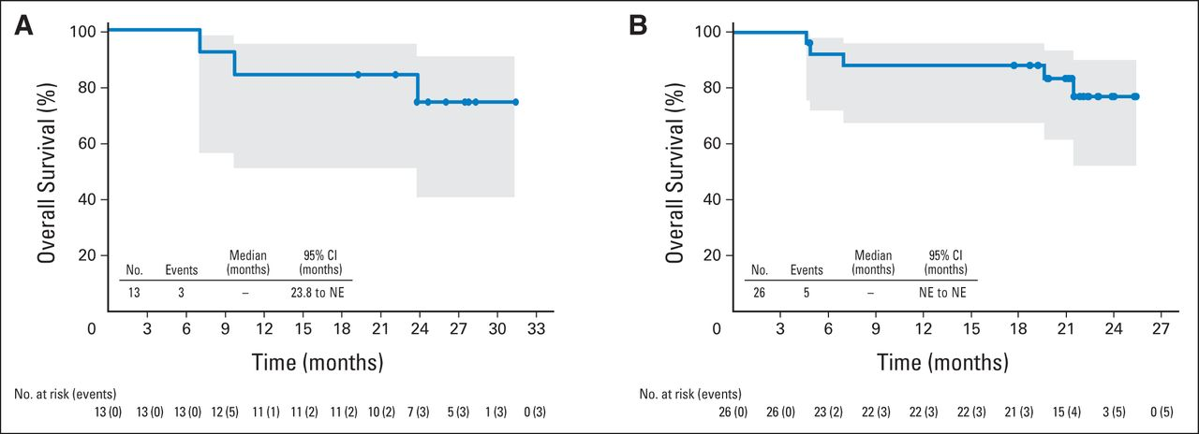
Outcomes
Sequential Treatment
Combination Treatment
Fanale MA, et al. J Clin Oncol. 2014;32(28):3137-3143.
Notes:
Eleven patients experienced progressive disease or
death after a median observation time of 21.4 months. Median progression-free
survival was not reached (95% CI, 11.7 to NE). Circles on the plot indicate
censored patients. Shaded area indicates the 95% CIs. NE, not estimable.

Slide 37
Echelon-2 Trial PTCL-CD30+ (> 10%) if ALK+ ALCL IPI >2
Day -28 to 1
6-8 x 21-day cycles
At completion of study treatment
Experimental Arm: brentuximab vedotin plus CHP (A+CHP)
Restageª
Follow-up (including end-of-treatment assessments)
Until progression , death, or analysis of the primary endpoint, whichever comes first
Randomization 1:1
Cycle 4 Restageª
Screening/Baseline CT/PET
Survival Status^{c}
Standard-of-Care Arm: CHOP
Restageª
N = 300
Primary endpoint:
PFS approx. 45% improvement
9
12
15
18
21
24^{b}
Additional CT restage (months after initiation of treatment) for both arms
ªCT and PET scans required
^{b}Additional CT scans every 6 months thereafter until progression per investigator, death, or analysis of the primary endpoint, whichever comes first
^{c}For patients with documented progression, continued follow-up for survival every 6 months until death or study closure, whichever comes first
Notes:
Red Green Blue (RGB) of accent colors:
Blue: 75, 111, 183
Mustard: 225, 149 57
Red/orange: 208, 97, 62
Green (same as logo): 0, 135, 81

Slide 38
Other Ongoing Phase III Trials Front-Line Therapy of PTCL
Study | Population | Endpoint | Setting
Immunotherapy
Alemtuzumab + chemo vs chemo | Newly diagnosed PTCL | EFS | Induction
Antimetabolite
Pralatrexate maintenance vs observation | Newly diagnosed PTCL | OS | Maintenance: Closed due to poor accrual
Histone deacetylase inhibitor
Romidepsin + CHOP vs CHOP | Newly diagnosed PTCL | PFS | Induction
Notes:
EFS, event-free survival; ORR, overall response rate; PFS, progression-free survival; PTCL, peripheral T-cell lymphoma.

Slide 39
Raising the Bar: Striving to Improve Initial Therapy of PTCL
Significant advances in biology have led to well defined molecular subsets

Slide 40
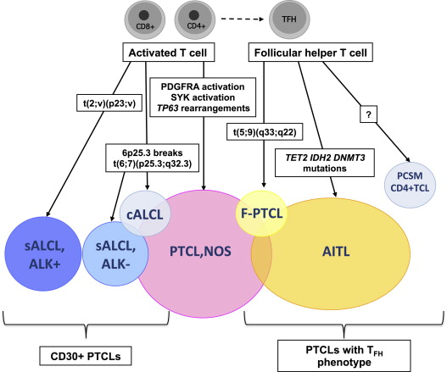
Putative Cellular Derivation and Known Oncogenic Pathways for the Main Nodal and Selected PTCL Entities
Philippe G, et al. Semin Hematol. 2014;51(1):5-16.

Slide 41
Potential Molecular Targets for Future Therapeutic Interventions in PTCL
Target | Function | Rationale | Agent | References
BCL2 | Antiapoptotic | Overexpressed in PTCL; correlates with poor prognosis | ABT-199 | Rassidakis et al, Souers et al
IDH2 | Metabolic enzyme | Mutated in AITL and PTCL-NOS; produced 2HG, which blocks chromatin-modifying enzymes | Mutant IDH2 inhibitor | Cairns et al, Wang et al
BRD4 | Epigenetic “reader” | BRD4 inhibition kills AML with mutant IDH2 (preclinical) | JQ1; iBET | Chen et al
FYN | Kinase | Activating mutations in AITL and PTCL-NOS | Dasatinib | Couronne et al
JAK2/STAT3 | Kinase | Pathway activation in AITL and PTCL-NOS | Ruxolitinib | Maurer et al
JAK3 | Kinase | Activating mutations in NKTCL | Tofacitinib | Koo et al
PI3Kδ and γ | Kinase | Promote growth/survival in PTCL | IPI-145 | Horwitz et al
MTOR | Kinase | Promotes growth/survival in PTCL | Everolimus | Kim et al
PDGFRα | Kinase | Pathway activation in PTCL | Imatinib | Piccaluga et al
Intlekofer AM, et al. Int J Hematol. 2014;99(3):249-262.
Notes:
References [60, 61, 98, 99, 102, 104, 112–116]
IDH Isocitrate dehydrogenase, RTK receptor tyrosine kinase
60. Piccaluga PP, et al. Gene expression analysis of peripheral T cell lymphoma, unspecified, reveals distinct profiles and new potential therapeutic targets. J Clin Invest. 2007;117(3):823–34.
61. Cairns RA, et al. IDH2 mutations are frequent in angioimmunoblastic T-cell lymphoma. Blood. 2012;119(8):1901–3.
98. Couronne L, et al. Activating mutations in fyn kinase in peripheral T-Cell lymphomas. Blood. 2013;122(21):811.
99. Koo GC, et al. Janus kinase 3-activating mutations identified in natural killer/T-cell lymphoma. Cancer Discov. 2012;2(7):591–7.
102. Maurer MJ, et al. In-vivo activation of STAT3 in angioimmunoblastic T Cell Lymphoma, PTCL not otherwise specified, and ALK negative anaplastic large cell lymphoma: implications for therapy. Blood. 2013;122(21):844.
104. Horwitz, SM, et al. Preliminary safety and efficacy of IPI-145, a potent inhibitor of phosphoinositide-3-kinase-δ, γ, in patients with relapsed/refractory lymphoma. ASCO Meeting Abstracts, 2013; 31(15 suppl) p. 8518.
112. Rassidakis GZ, et al. BCL-2 family proteins in peripheral T-cell lymphomas: correlation with tumour apoptosis and proliferation. J Pathol. 2003;200(2):240–8.
113. Chen C, et al. Cancer-associated IDH2 mutants drive an acute myeloid leukemia that is susceptible to Brd4 inhibition. Genes Dev. 2013;27(18):1974–85.
114. Kim SJ, et al. A phase I study of everolimus and CHOP in newly diagnosed peripheral T-cell lymphomas. Invest New Drugs. 2013;31(6):1514–21.
115.Souers AJ, et al. ABT-199, a potent and selective BCL-2 inhibitor, achieves antitumor activity while sparing platelets. Nat Med. 2013;19(2):202–8.
116. Wang F, et al. Targeted inhibition of mutant IDH2 in leukemia cells induces cellular differentiation. Science. 2013;340(6132):622–6.

Slide 42
Q1: What Would You Recommend As Initial Therapy?
CHOP (cyclophosphamide, doxorubicin, vincristine, prednisone)
CHOEP (cyclophosphamide, doxorubicin, vincristine, etoposide, prednisone)
Hyper-CVAD (cyclophosphamide, vincristine, doxorubicin, prednisone)
Brentuximab vedotin
Gemcitabine + cisplatin-based regimen

Slide 43
Q2: What Would You Do Next?
Observation without further therapy
Consolidate with high-dose therapy (HDT) and autologous stem cell transplant (ASCT)
Type siblings for possible allogeneic transplant (allo-SCT)
Start maintenance brentuximab vedotin

Slide 44
Take-Home Message
Standard CHOP; does not work well for most subtypes
Clinical trial should always be first choice
Off trial: etoposide-based regimen for ALCL or pts less than age 60 y for other histologies
If CR (PTCL-NOS, ALK – ALCL, AILT), consider consolidation with SCT
Improved understanding of biology and has offered some clarity to the broader term ‘PTCL’
Specific entities defined
Molecular-based prognostic markers identified
Potential new targets identified that provide a rationale for new approaches to therapy

